Slide 1
Programmable interval timer 8253
Md. Fazle Rabbi
ID:16CSE057

Slide 2
Contents
Block Diagram of the 8253System
Interfacing of the 8253Interfacing the
8253 to the 8086 Processor
Programming the 8253
Operating Modes of the 8253

Slide 3
What is 8253?
The Intel 8253 is a programmable counter/ timer chip designed for use as an Intel microcomputer peripheral.
It is packaged in a 24-pin plastic DIP.
Six programmable timer modes allow the 8253 to be used as an event counter, elapsed time indicator, programmable one-shot, and in many other applications e.g., to create different intervals.
It has 3 counters: – Counters 0, 1, 2

Slide 4
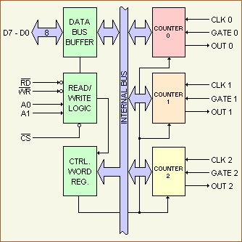
Block Diagram of 8253
Each counter in the block diagram has 3 lines connected to it. Two of these lines, clock and gate, are inputs. The third, labeled OUT is an output.
The function of these lines changes and depends on how the device is initialized or programmed.

Slide 5
Block Diagram of 8253
Data Bus Buffer : The 3-state, bi-directional, 8-bit buffer is used to interface the 8253 to the system data bus.
Data is transmitted or received by the buffer upon execution of IN or OUT CPU instructions.
The Data Bus Buffer has three basic functions :
(1) Programming the MODES of the 8253.
(2) Loading the count registers.
(3) Reading the count values.

Slide 6
Read/Write Logic
The Read/Write Logic accepts inputs from the sys- tem bus and in turn generates control signals for overall device operation.
It is enabled or disabled by CS’ so that no operation can occur to change the function unless the device has been selected by the system logic.
Control Word Register:
The Control Word Register is selected when A0A1 = 11.
It then accepts information from the data bus buffer and stores it in a register.
The information stored in this register controls the operation MODE of each counter, selection of binary or BCD counting and the loading of each count register.
The Control Word Register can only be written into; no read operation of its contents is available.

Slide 7
Counter 0, Counter 1, Counter 2:
These three functional blocks are identical in operation so only a single counter will be described.
Each Counter consists of a single, 16-bit, pre-settable, DOWN counter.
The counter can operate in either binary or BCD and its input, gate and output are configured by the selection of MODES stored in the Control Word Register.
The counters are fully independent and each can have separate MODE configuration and counting operation, binary or BCD.
Also, there are special features in the control word that handle the loading of the count value so that software overhead can be minimized for these functions.
The reading of the contents of each counter is available to the programmer with simple READ operations for event counting applications and special commands and logic are included in the 8253 so that the contents of each counter can be read "on the fly" without having to inhibit the clock input.

Slide 8
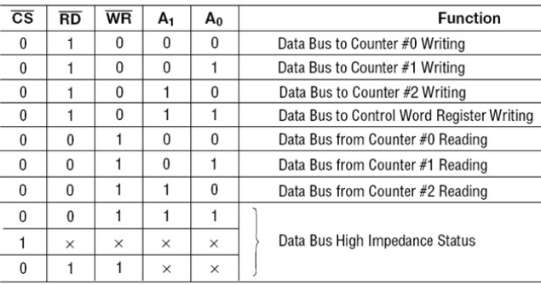
Basic operations of the 8253
Types of Robots
1) Mobile robots.
2) Industrial robots
3) Autonomous robots
4) Remote-controlled robots.
5) Virtual robots.

Slide 9
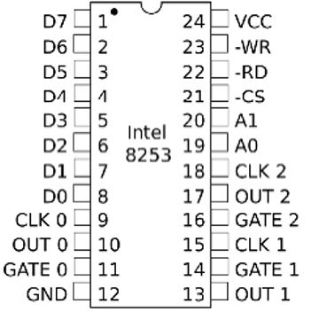
Pin Configuration of the 8253

Slide 10
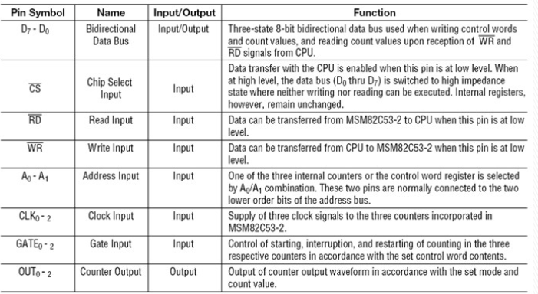
Pin description of the 8253.

Slide 11
Modes of Operation of 8253
There are 6 modes of operation of 8253
Differences in modes are: – “OUT” signal in different shapes like low-high or high- low, periodic or non-periodic – How to trigger/start the counter
Mode 0 and 1 are same in shape (non-periodic)
Mode 4 and 5 are same in shape (non-periodic)
Mode 2 and 3 are almost same in shape (periodic)

Slide 12
Modes of Operation of 8253
Mode 0: Set Output Bit when timer done. The output will start off zero. The count is loaded and the timer will start to count down. When the count has reached zero the output will be set high, and remain high until the next count has been reloaded.
Mode 1: Programmable One-Shot. The output will go low following the rising edge of the gate input. The counter will count and the output will go high once the counter has reached zero.

Slide 13
Modes of Operation of 8253
Mode 2: Rate Generator. The counter will continually count down, when the count reaches zero, the output will pulse low and the counter will be reloaded.
Mode 3: Square Wave Generator. This mode is similar to Mode 2 except the output remains low for half of the timer period and high for the other half of the period.

Slide 14
Modes of Operation of 8253
Mode 4: Software Triggered Pulse. The output will remain high untill the timer has counted to zero, at which point the output will pulse low and then go high again.
Mode 5: Hardware Triggered Pulse. The counter will start counting once the gate input goes high, when the counter reaches zero the output will pulse low and then go high again.

Slide 15
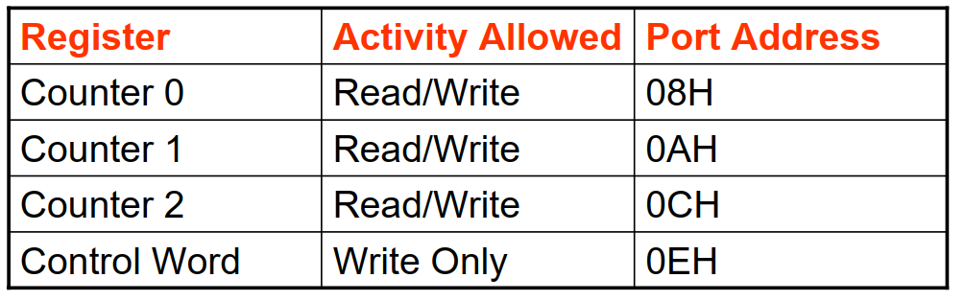
Modes of Operation of 8253
If 6 is loaded in the counter then it will start count down from 6 0. After reaching 0, change the OUT signal like from Lo Hi. • First 2 MSBs select the counter. Addresses for 3 counters in flight board’s 8253 are:

Slide 16
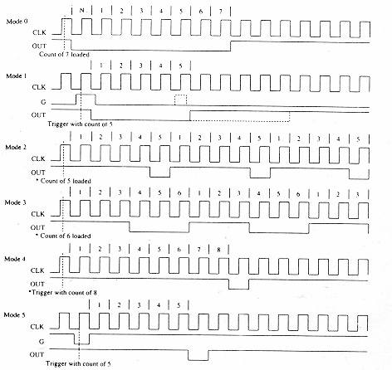
Modes of Operation of 8253
If 6 is loaded in the counter then it will start count down from 6 0. After reaching 0, change the OUT signal like from Lo Hi. • First 2 MSBs select the counter. Addresses for 3 counters in flight board’s 8253 are:

Slide 17
THE END

